Slide 1
Manage & Administrate of Yas smart devices
شركة ياس للانظمة الالكترونية
YAS Electronic Systems,
United Arab Emirates.
Phone: +97165333779
Email: info@yas.solutions

Slide 2
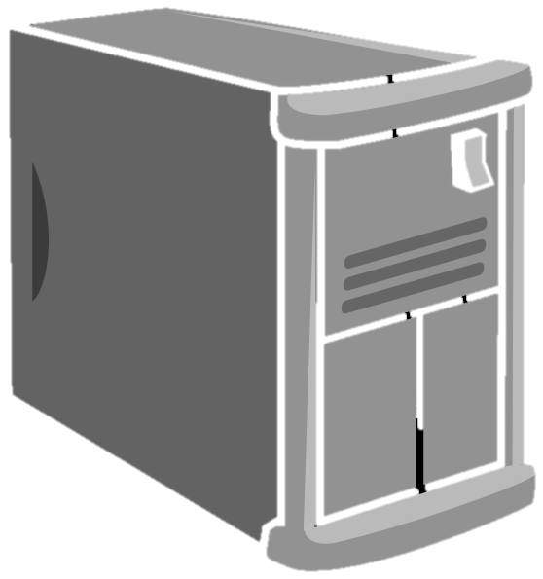

User token flow
Yas Smart home server
Generate
Device Token 1
3
Generate
Generate
2
1
Device Token 2
Sign up
Registration
User Token
4
………..
Generate
Device Token ..n
…..

Slide 3

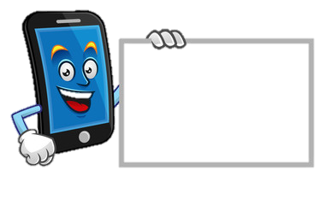
Create new yas smart Device operation
Bay yas smart Device
3
Generate
Yas Smart home server
Device Token 1
1
2
Login and Add Device
4
Setup Device configuration
Customer
Use Wifi manager to insert :
SSID and its Password
YAS -User token
YAS-Device token
User Token

Slide 4
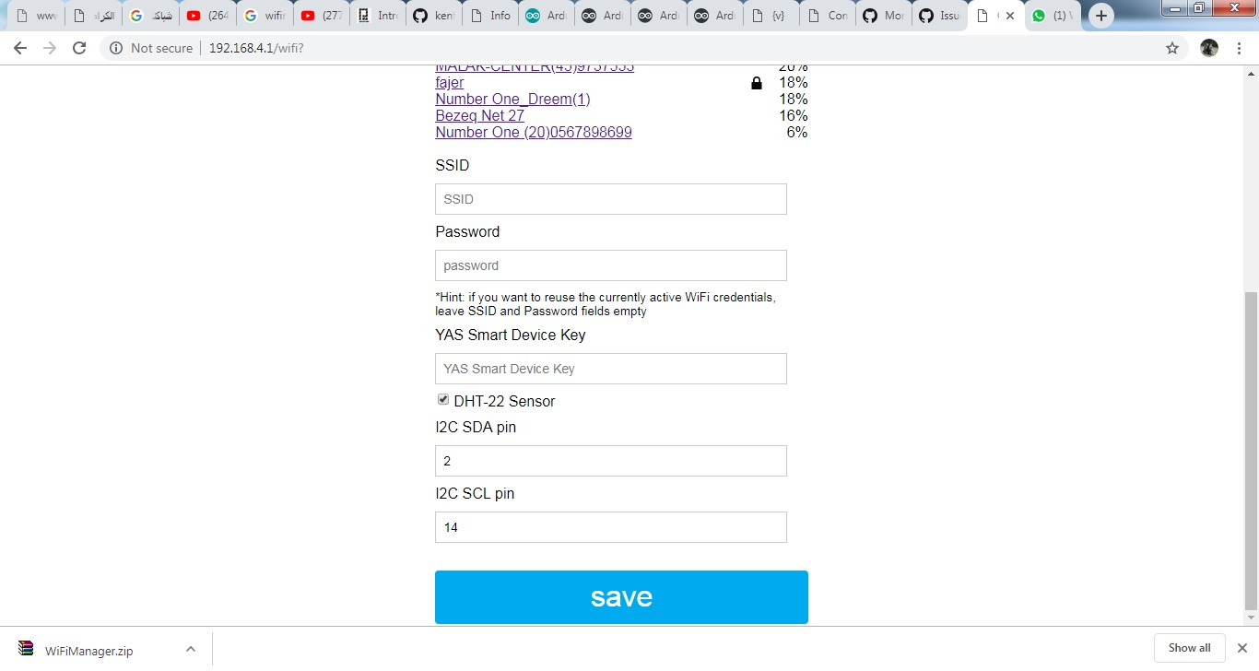
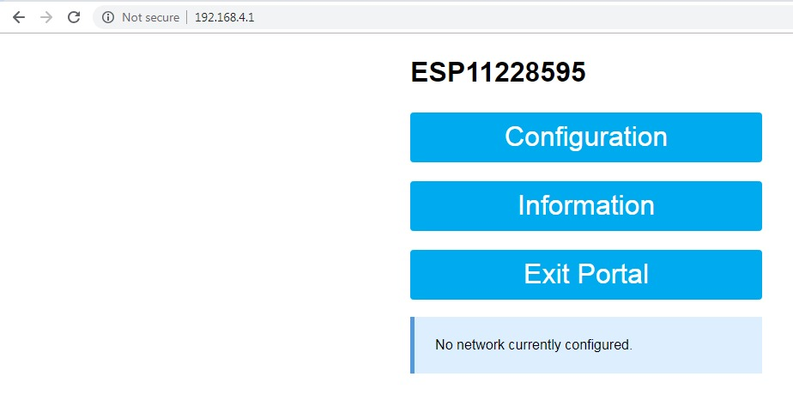
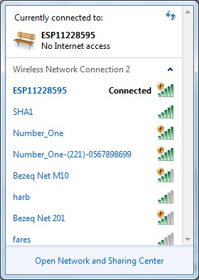
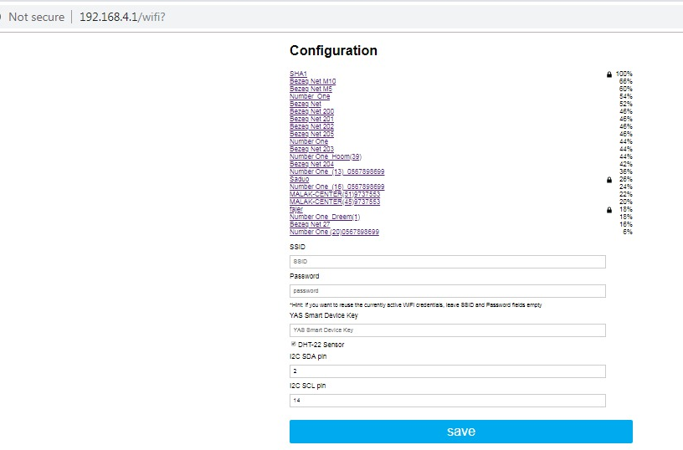
Setup new Device by Wifi configration
IP : Device Access point
Use Wifi manager to insert :
SSID and its Password
YAS -User token
YAS-Device token
2
Setup Device configuration
4
1
3

Slide 5
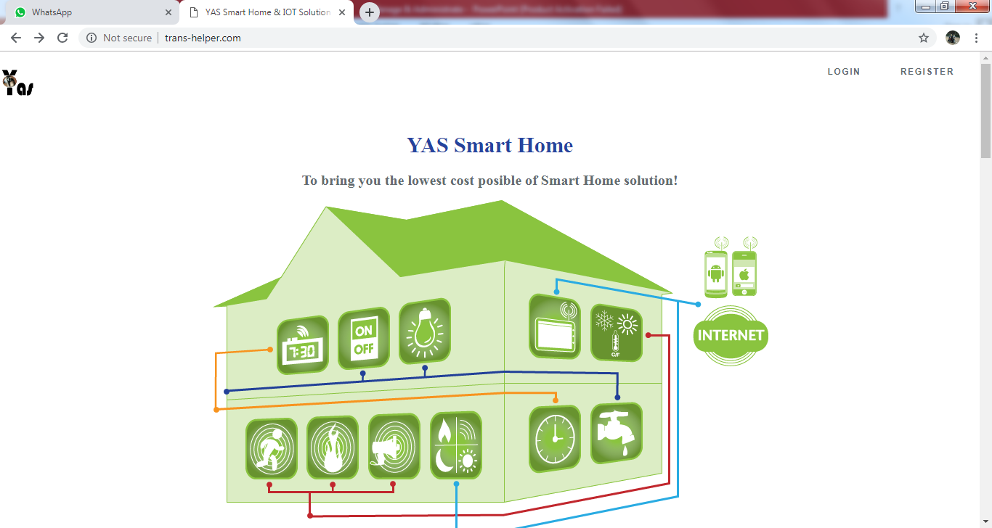
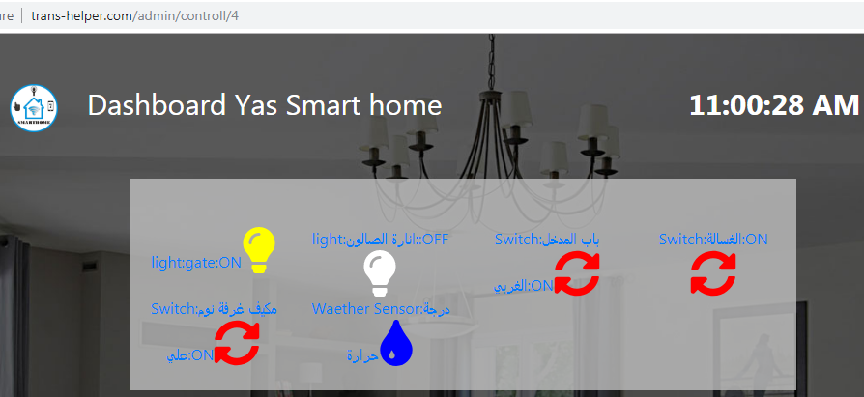
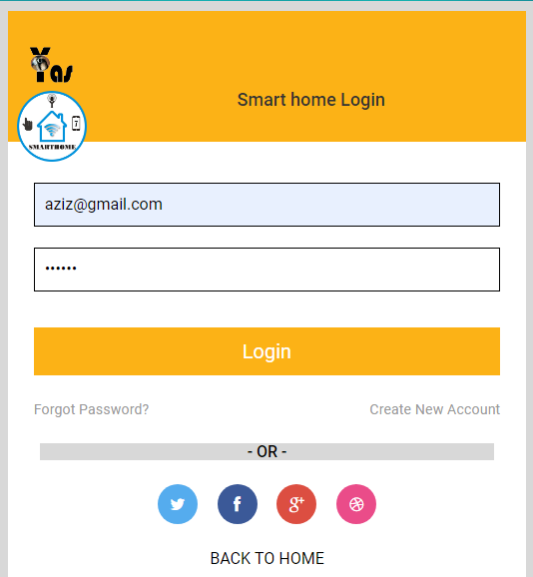
Access to Dashboard YAS Smart Home
1
….
2

Slide 6
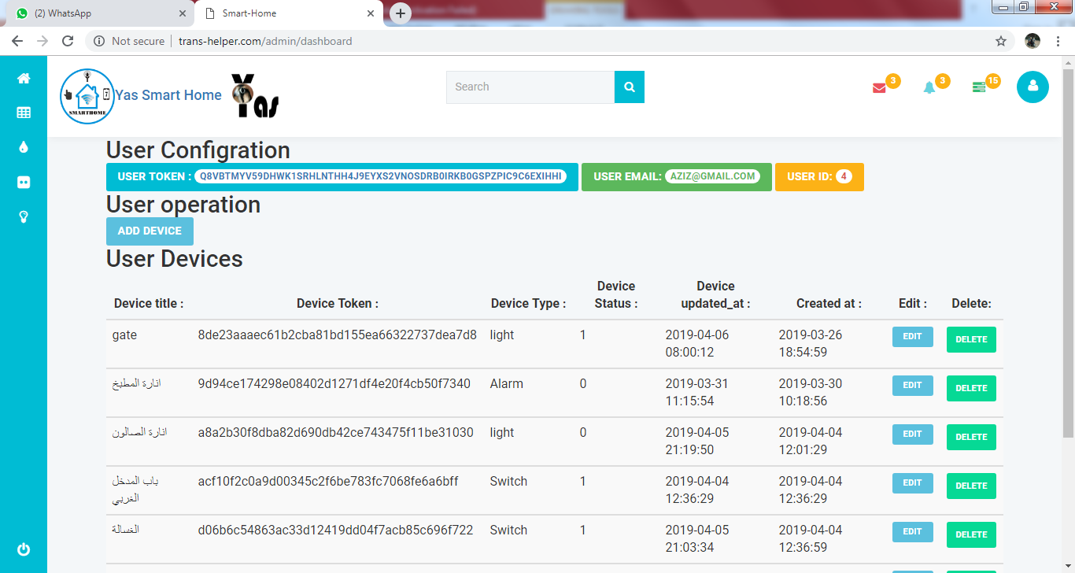
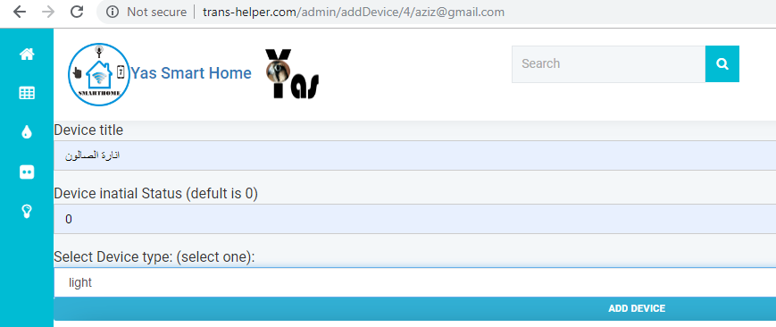
Add new device to Dashboard YAS Smart Home
1
2
….
3

Slide 7
Edit device details at YAS Smart Home
1
Select the device want edit it (change name or type)
….
2
3

